Slide 1
Confidential – Not for distribution outside of your organization
Global Asset Management Insights
Insights Partner Report
For Brazil participants in our Global Asset Management Study
July 2024

Slide 2
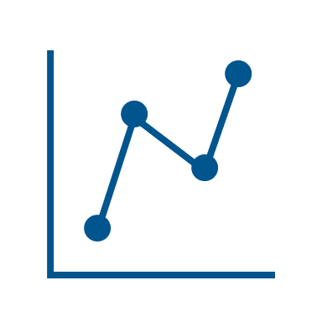
Introduction, an independent global perspective
Underlying Research
Summary Insights
Annual global research study to inform asset managers and investment buyers of client needs, behavioural drivers and competitive strengths and weaknesses
Manager performance
Itau AM (Itau Unibanco) ranked 1st amongst institutional audiences and XP Investimentos ranked 1st with wholesale fund buyers on NMG’s unprompted brand ranking
Purpose
Thought leadership
Interest rates, ESG and inflation are key topics of interest among institutional investors and wholesale fund buyers. Advisers are interested in topics surrounding the macro economy, Brazil and China
Approach
Independent structured interviews with investment decision makers within institutional asset owners, asset consultants, wholesale fund buyers and financial advisers
Asset allocation
Investors are diversifying away from domestic fixed income and are seeking opportunities in domestic and global equities
This report
This report shares findings with the 137 Brazil participants who took part in the study during the period October 2023 to February 2024
Growth and performance are leading concerns among all audiences. Competition and client acquisition are top of mind with retail audiences
Key challenges
Value added support
Portfolio commentary, business partnership and market commentary offer the greatest value-added support for institutional and wholesale fund buyer audiences
Notes: 1. For more insights or further information, please contact Karen Lau at karen.lau@nmg-group.com

Slide 3
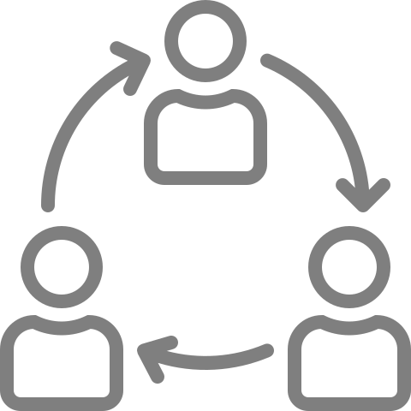
Domestic managers dominate the top-10 brand ranks across audiences
Top-10 Asset Managers Brand Ranking (Brazil, 2023)
Institutional Brand Rank
(out of 148 asset managers)
Retail Brand Rank
(out of 256 asset managers)
Change in rank vs. 22
= | 1 | Itau AM (Itau Unibanco)
↑ | 2 | BTG Pactual
= | 3 | SPX Capital
↓ | 4 | XP Investimentos
↑ | 5 | BlackRock
↑ | 6 | JGP
↑ | 7 | BB AM (Banco do Brasil)
= | 8 | Kinea (Itau)
= | 9 | Vinci Partners
↓ | 10 | J.P. Morgan AM
= | 1 | XP Investimentos
= | 2 | BTG Pactual
↑ | 2 | Itau AM (Itau Unibanco)
↑ | 4 | Kinea (Itau)
↓ | 5 | Verde Asset Management
↑ | 6 | BlackRock
= | 7 | J.P. Morgan AM
↓ | 8 | Ibiuna Investimentos
↓ | 9 | SPX Capital
↑ | 10 | Kapitalo Investimentos
BTG Pactual rose to 2nd (from 4th), driven by greater recognition for domestic equity and multi-asset (1st) capabilities, along with greater perceptions of innovative and client-focused (1st)
BlackRock lifted to 6th (from 10th) with greater recognition in international equity and emerging market equity (1st) capabilities, along with increased perceptions of having a global perspective (1st), ESG and industry leadership
BB AM (Banco do Brasil) rose to 7th (from 38th), driven by increased recognition for domestic fixed income and liquid alternatives (1st), along with multiple brand attributes (trusted, industry leadership, client focused, transparent, ease of doing business, thought leader)
Kapitalo Investimentos lifted to 10th (from 14th) with increased recognition across brand capabilities (consistent, transparent, innovative, thought leader)
Notes: 1. Brand ranking is determined based on top of mind nominations for the asset manages across overall brand awareness, asset class offerings, and capabilities, averaged over 2022 and 2023
2. Overall retail rank is calculated by giving equal weighting to rank in wholesale fund buyer and financial adviser
3. Arrows indicate the manager’s change in ranking (2022 vs. 2023). “=“ indicates no change in its rank

Slide 4
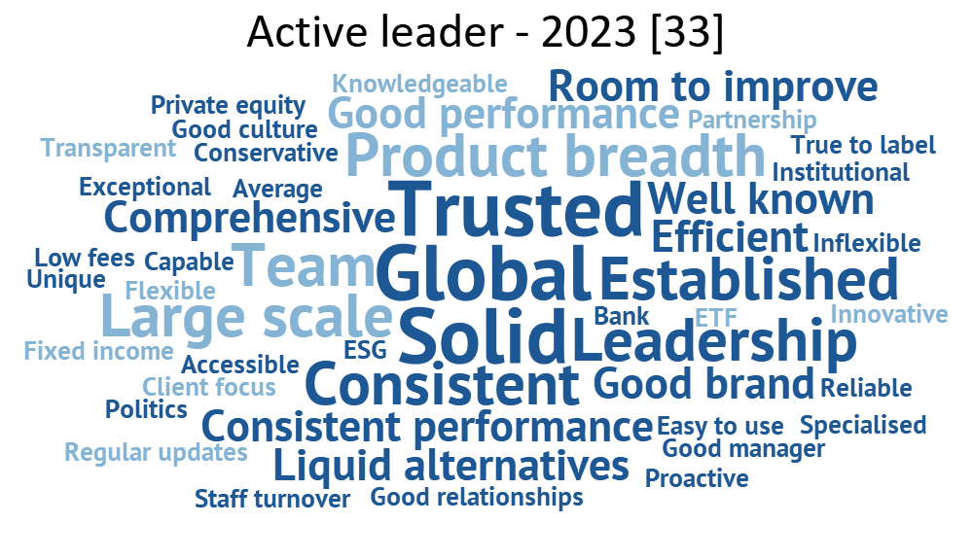
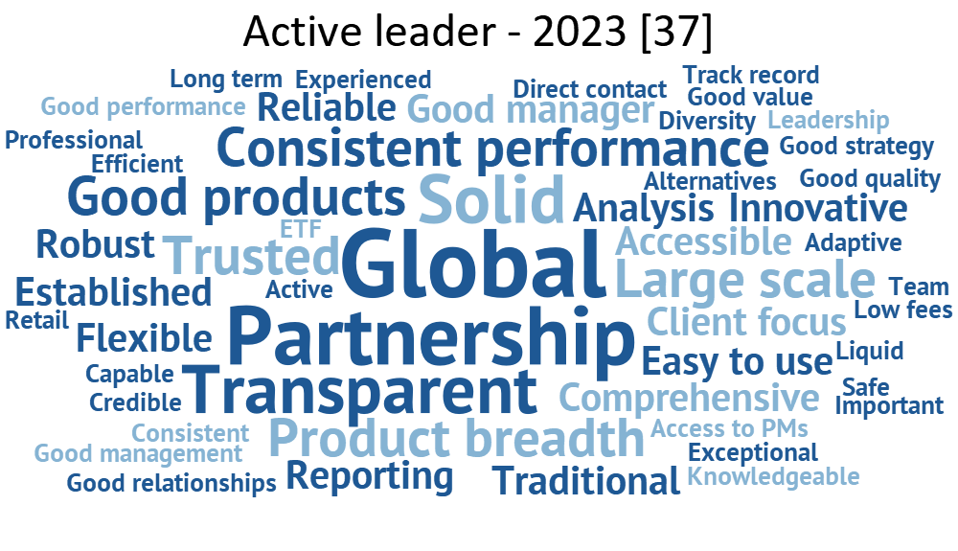
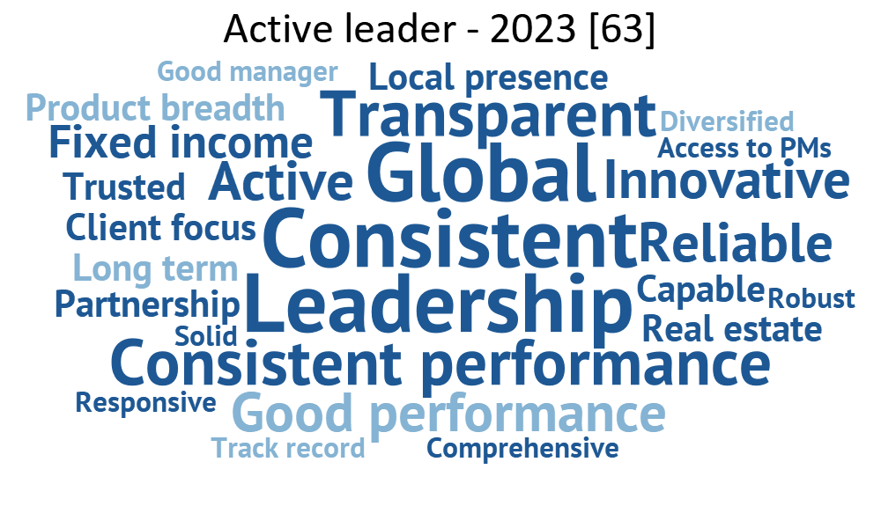
Lead managers are regarded for having global capabilities and establishing solidity through trust, transparency and consistency
Lead active manager brand profile (Brazil, 2023)
Institutional
Wholesale fund buyer
Financial adviser
Institutional investors regard their lead asset managers for having large global capabilities, along with establishing trust and consistency
Wholesale fund buyers regard their lead asset managers most for having global capabilities, focusing on partnership and being transparent
Advisers in Brazil acknowledge their key managers for being a global leader, demonstrating consistent and strong performance, and being transparent
Notes: 1. Change from prior year: Increase Decrease Stay the same
2. The Active Leader is defined as the most important asset manager for active for a given respondent

Slide 5
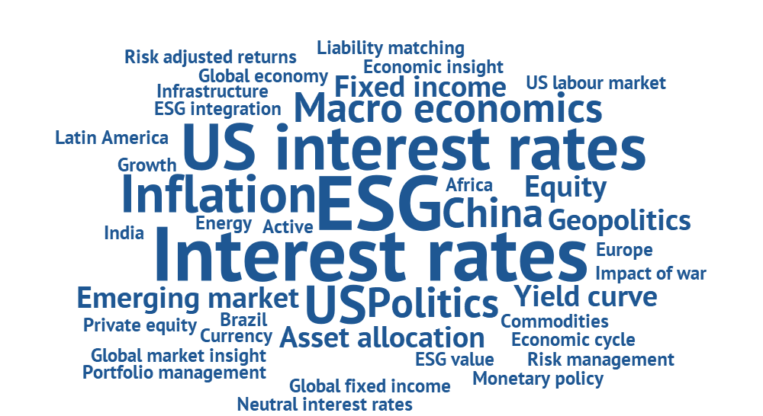
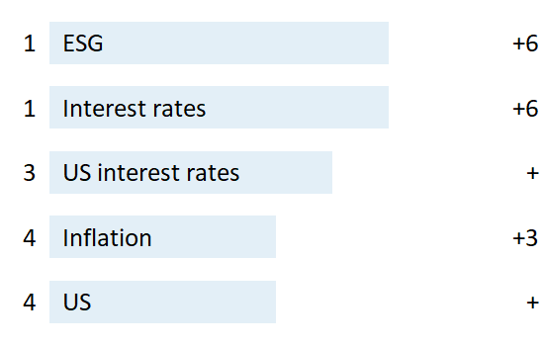
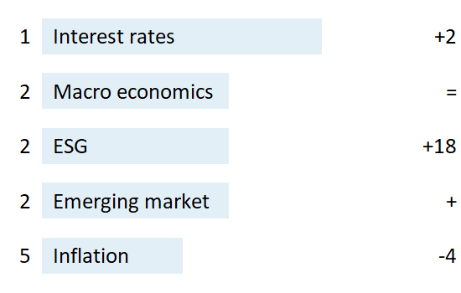
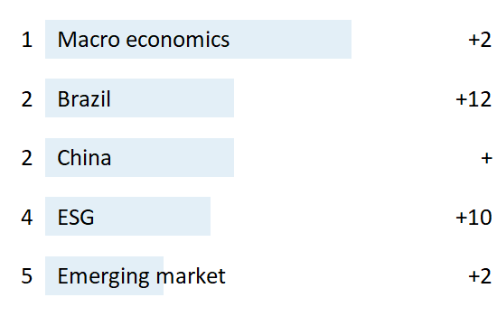
ESG and interest rates are leading topics with institutional and wholesale fund buyers. The macro economy, Brazil and China themes are of interest with advisers
Thought leadership topics of interest in the next 12 months (Brazil, 2023)
Top 5 topics
2023 Rank
Change in rank vs. 22
↑
↑
↑
↑
↑
Interest rates, ESG and inflation are key topics of interest with institutional and wholesale fund buyers
Institutional
↑
=
↑
↑
↓
Emerging market themes are also of interest with retail audiences
Wholesale fund buyer
↑
↑
↑
↑
↑
Advisers are primarily interested in the macro economy, Brazil and China
Financial adviser
Note: 1. Arrows indicate the topic’s change in ranking (2022 vs. 2023).

Slide 6
Retail audiences report a higher AI adoption rate than institutions, using AI for client engagement, internal operational efficiency and investment research & analysis
% Using AI tools
Top 3 uses of Artificial Intelligence techniques by firms (Brazil, 2023)
1. Internal operational efficiency
2. Asset manager due diligence
3. Client engagement
Using AI for faster and more widespread access to corporate and market information.
Pension Fund, Brazil
We use it more in building reports and AI builds the texts. We are also going to invest in using AI for investment analysis.
Asset Consultant, Brazil
It's important, it optimizes several routines and saves time. Pension Fund, Brazil
“
“
“
Institutional
Institutional
23%
1. Client engagement
2. Internal operational efficiency
3. Investment research & analysis
It exists only to filter and direct customer service.
Wholesale Fund Buyer, Brazil
Very positive to gain scale and efficiency and reduce operational cost.
Wholesale Fund Buyer, Brazil
Sometimes we need to make an information filter and then we use AI for that, so it's more like an initial polish.
Wholesale Fund Buyer, Brazil
“
“
“
Wholesale fund buyer
34%
1. Client engagement
2. Investment research & analysis
3. Internal operational efficiency
More interesting language for high-income customers.
Financial Adviser, Brazil
Assist in programming internal market research solutions.
Financial Adviser, Brazil
Content creation (communication and marketing) and research to optimize routines. Financial Adviser, Brazil
Financial adviser
50%
“
“
“

Slide 7
Investors are seeking to diversify away from domestic fixed income. They are seeing opportunities in domestic and global equity
Reported asset mix and asset allocation intentions (Brazil, 2023)
Institutional
Retail
60%
Infrastructure
70%
International FI
Multi-Asset
50%
60%
Infrastructure
Domestic Equity
50%
Global Equity
40%
Target Date Funds
40%
30%
Global Equity
Private Equity
30%
Private Debt
Net allocation intention (% respondents)
Net allocation intention (% respondents)
Liquid Alternatives
Domestic Equity
Real Estate
20%
20%
Private Equity
Liquid Alternatives
10%
International FI
10%
Private Debt
EM Equity
Multi-Asset
0%
EM FI
0%
-10%
Domestic FI
Real Estate
Domestic FI
-10%
-20%
0%
10%
20%
30%
40%
50%
60%
0%
10%
20%
30%
40%
50%
Asset allocation (% AUM)
Asset allocation (% AUM)
Note: 1. Net allocation intention (% of respondents) denotes the proportion of respondents who quoted an expected increase less % of respondents quoting a decrease
2. Increase in allocation Decrease in allocation

Slide 8
Growth and performance are leading concerns among all audiences. Competition and client acquisition are also top of mind with retail audiences
Top 3 greatest challenges expected in next 12 months (Brazil, 2023)
Institutional
Wholesale fund buyer
Financial adviser
Change in rank vs. 22
1 | Performance | ↑
2 | Growth | ↑
3 | Interest rates | ↑
1 | Growth | =
2 | Competition | ↑
3 | Performance | ↓
1 | Growth | =
2 | Client acquisition | ↑
3 | Performance | ↓
“
“
“
Adjusting your performance to your actuarial goal.
Pension Fund, Brazil
Growing AUM without losing quality for our established base, delivering positive results for clients.
Wholesale Fund Buyer, Brazil
Raising new funds and profitability of managed funds.
Financial Adviser, Brazil
Maintaining the 10% growth ratio in the next year.
Insurer, Brazil
Probably the biggest challenge will be keeping our margins, due to competition I do not think this will be possible.
Wholesale Fund Buyer, Brazil
Attracting new advisers and new clients.
Financial Adviser, Brazil
“
“
“
Note: 1. Top challenges are colored into the following categories: Fund performance: Business growth: Economy:
2. Arrows indicate the challenge’s change in ranking (2022 vs. 2023). “=“ indicates no change in its rank

Slide 9
Portfolio commentary, business partnership and market commentary offer the greatest value-added support for institutional and wholesale fund buyer audiences
Top 3 stated value-added support drivers (Brazil, 2023)
Institutional
Wholesale fund buyer
Change in rank vs. 2022
1
Portfolio commentary
↑
1
Portfolio commentary
↑
2
Business partner
↑
2
Business partner
↓
3
Market commentary
↓
3
Market commentary
↑
Note: 1. Stated importance (‘what they say’) is based on what the respondents state are the most important value-added support drivers
2. Arrows indicate the factor’s change in stated importance ranking (2022 vs. 2023). “=“ indicates no change in its stated importance rank

Slide 10
Valor Economico and Pipeline Valor are the key digital investment information sources with financial advisers
Regular digital sources for investments information (Financial adviser, Brazil, 2023)
Rank
Source
% Advisers
Do you access this source via a mobile app?
Do you pay for this subscription?
1
Valor Economico
2
Pipeline Valor
3
XP Investimentos
3
InfoMoney
5
Bloomberg
Note: 1. % Advisers shows the # of citations for the respective source out of the number of respondents responded with a source
2. Shaded portion of the pie chart represents the number of respondents who answered “yes”, out of all respondents who provided an answer to the question

Slide 11
Thank you
For more information about NMG, visit www.nmg-consulting.com
For more insights or further information on our Global Asset Management Study, please contact Karen Lau at karen.lau@nmg-group.com
LONDON · SINGAPORE · SYDNEY · TORONTO · CAPE TOWN · NEW YORK

